Slide 1
Scrum-Agile
Jhariel Almonte Ventura

Slide 2


The Scrum-Agile Team
Product Owner
The product owner is the logistical representation of the development process a project. The product owner ensures the development team is following the vision of the project and achieving progress towards a final functional product that meets the needs of the clients and their requests, defines the acceptance criteria, and prioritizes the features. Additionally, they act as a liaison between the stakeholders and the development team.
Scrum Master
The scrum master is described as a servant-leader member of the team, and often acts as a supportive member, or a manager, as they also ensure the team is on the same page to deliver the expected results during each iteration through continuous improvement and implementation.
Development Team
The development team are the individuals who essentially, get things done during each Sprint iteration . The team consists of self-sufficient developers and testers who are responsible for the continuous implementation of features and requests made by the stakeholders or product owner.
Stakeholders and Clients
Product Owner
Scrum Master
Development Team

Slide 3
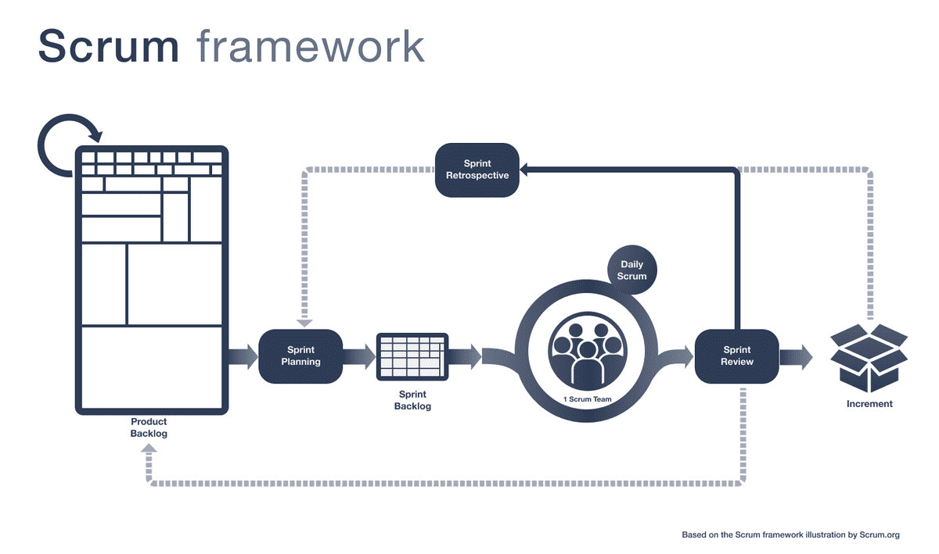
Scrum-Agile Framework
Figure: Scrum Mate - Scrum Framework at a Glance - https://scrummate.com/agile-guide/scrum-framework/

Slide 4
Scrum-Agile Framework: Artifacts
Sprint
Sprints are time-framed iterations of the development process, mostly between two weeks to a month. During this period, all other artifacts are implemented, and the development and implementation of features take place. Essentially the foundation of the framework.
Sprint Planning
During this period, the team conducts a meeting to determine goals and decides which features will be implemented from the product backlog.
Product Backlog
The product backlog is essentially the fundamental structure and features the team needs to implement. This is the main source of tasks and deliverables for the entire project.
Sprint Backlog
The sprint backlog are the features that need to be implemented during the sprint. These tasks are prioritized and assigned by the product owner prior to the sprint.
Daily Scrum
Daily scrums are 15–20-minute daily meetings, usually conducted first thing in the morning to review their progress. During these meetings, the development team discusses what they have accomplished since the last meeting, what they will work on, and any issues they may have encounter.
Sprint Review
At the end of each iteration, the stakeholders and every member of the development team meet to review the progress made during the sprint.
Sprint Retrospective
The sprint retrospective is similar to the sprint review. However, this is an internal meeting between the development team where they reflect on the performance, the success, failures and how to make improvements and prepare for the next sprint.

Slide 5
Waterfall or Agile?
Waterfall is a strictly plan-based software development framework that essentially, once the plan is set, there is not going back. Which leaves not room to go back to make changes during the iteration or even troubleshoot unexpected code-related issues. Agile in the other hand, is a flexible priority-based framework that allows the development team to make sudden changes and the implementation of new features requested by the stakeholders, such as in our case, where we had to restructure the project as our client was changing directions on their requests. Had we implemented the Waterfall framework in place of Agile, we would not have been able to make such effective and quick changes to the project in such a short notice, which more than likely would have affected the delivery of the final product considering the deadline remained unchanged despite the demanding request.
However, I strongly believe we could benefit from the Waterfall framework if we know from the beginning of the development process that our clients would not request changes that could potentially affect the fundamental structure of the program. Although there are other factors that could affect this decision such as unexpected technical issues and bugs!

Slide 6
Reference
Scrum Mate. Scrum Framework at a Glance. https://scrummate.com/agile-guide/scrum-framework/

